Slide 1
MBA532 – AI in Business
MODULE 5 – AI’s impact on Work, Jobs, Humans, Productivity

Slide 2
Generative AI-Driven Productivity Impact
Predictions: Generative AI Driven Productivity Impact

Slide 3
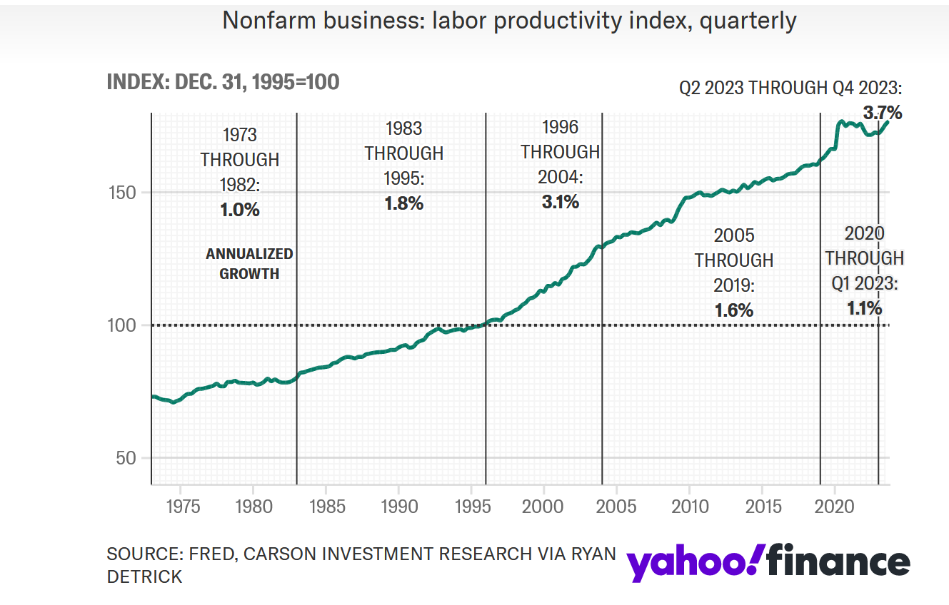
Recent Regime Shift in US Productivity?

Slide 4
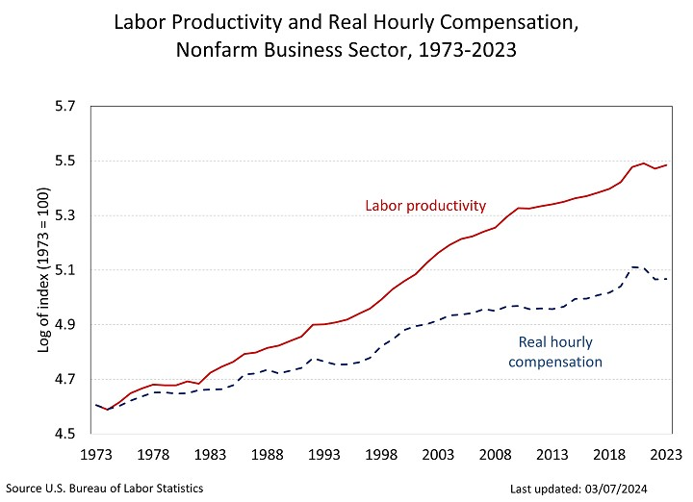
Labor Productivity and hourly costs (1973-2023)

Slide 5
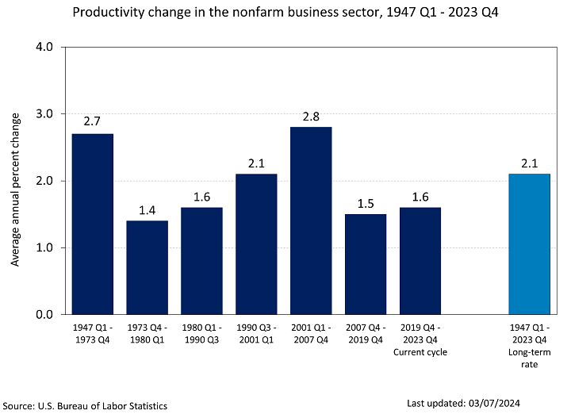
Productivity Change in the Nonfarm business sector (1947-2023)

Slide 6
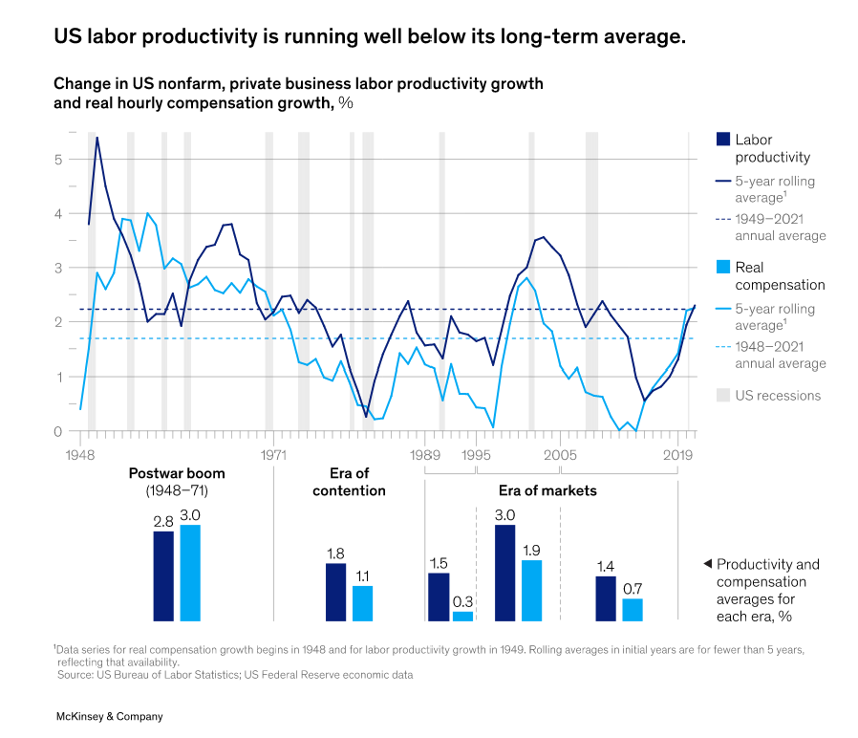
Source: Rekindling US Productivity Growth in a new era, McKinsey Global Institute, February 16, 2023

Slide 7
McKinsey Digital Report (June 2023)
According to this McKinsey report “The Economic Potential of Generative AI: The Next Productivity Frontier”:
Generative AI is likely to add the equivalent of $2.6 trillion to $4.4 trillion annually to the world economy across the 63 use cases analyzed—by comparison, the United Kingdom’s entire GDP in 2021 was $3.1 trillion. This would increase the impact of all artificial intelligence by 15 to 40 percent. This estimate would roughly double if the impact of embedding generative AI into software that is currently used for other tasks beyond those use cases is also considered.
generative AI and other technologies have the potential to automate work activities that absorb 60 to 70 percent of employees’ time today.
Generative AI could enable labor productivity growth of 0.1 to 0.6 percent annually through 2040

Slide 8
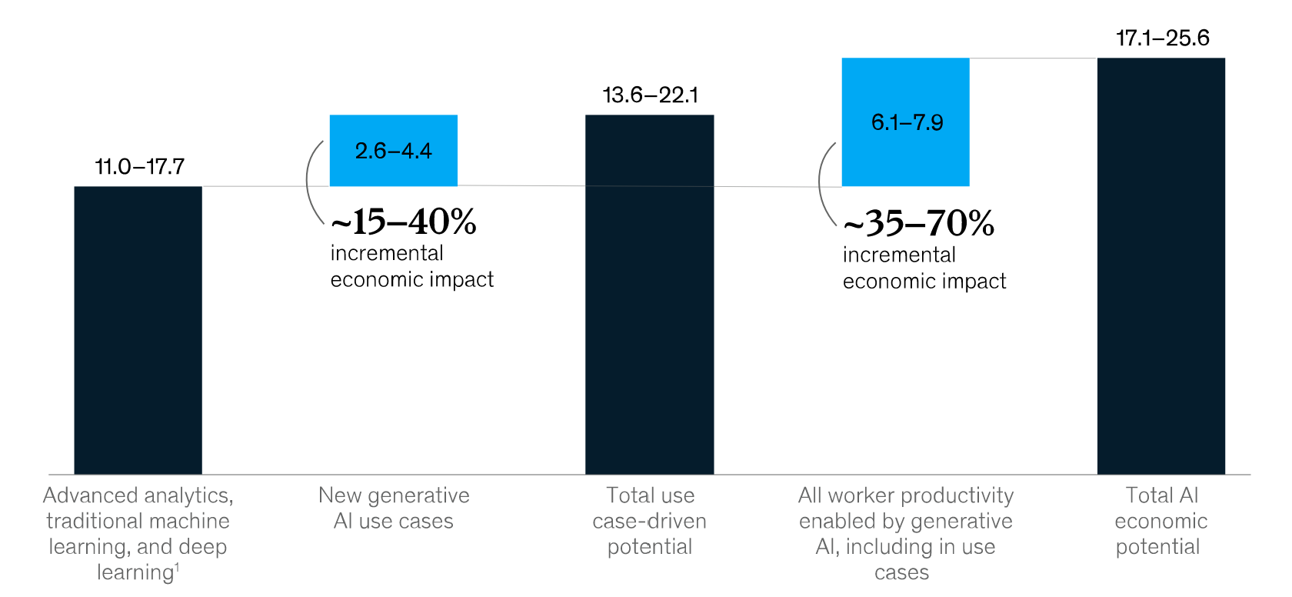
Incremental economic impact of Generative AI (Trillions of US Dollars – source: McKinsey)

Slide 9
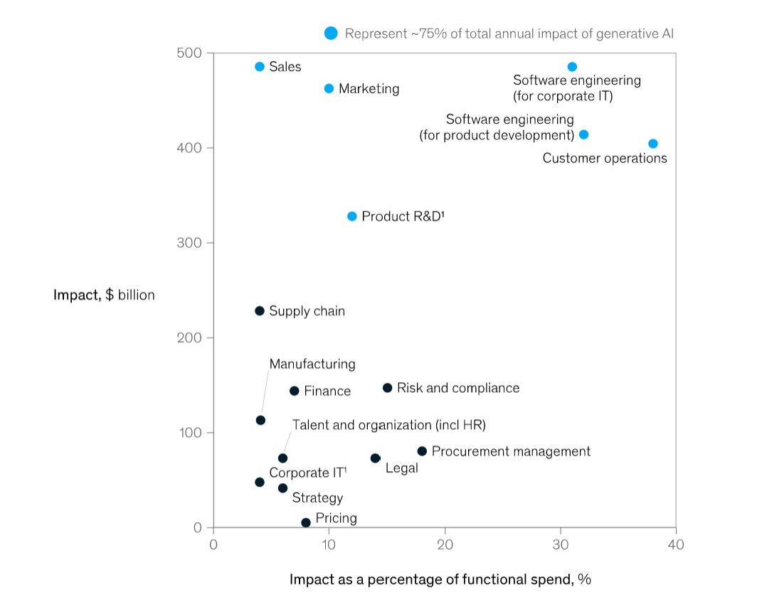
Where is the impact of Generative AI likely to manifest…. (source: McKinsey)

Slide 10
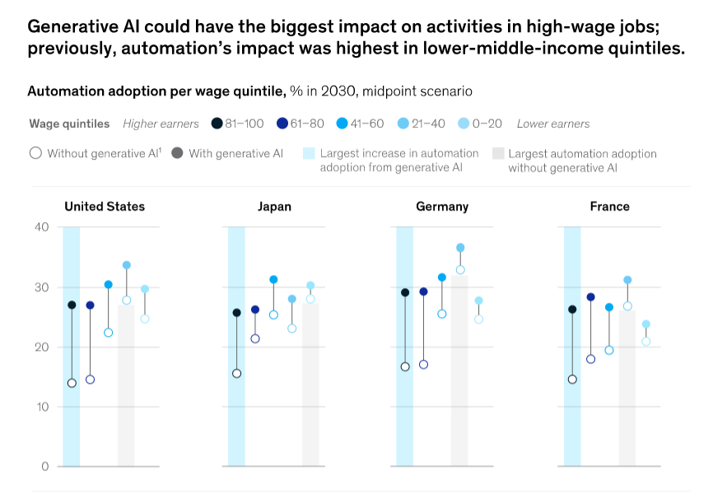
Generative AI Impact – across income quintiles (source: McKinsey)

Slide 11
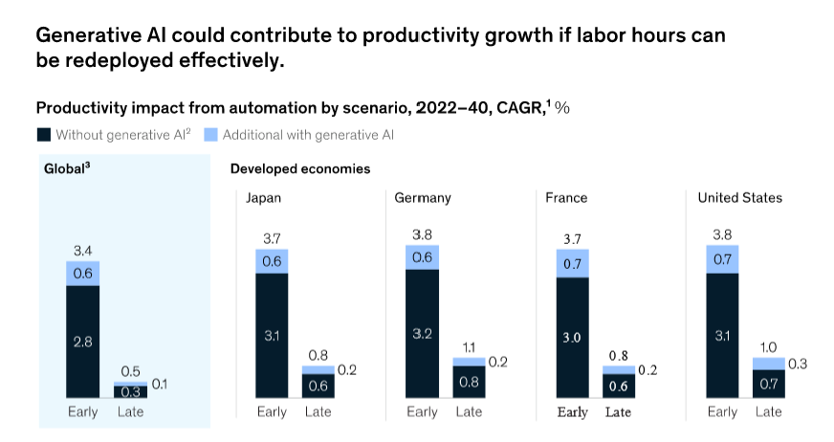
Generative AI: Contribution to Productivity Growth across countries (source: McKinsey)

Slide 12
Generative AI Impact – Research studies
Generative AI Impact from Academic Research Studies

Slide 13
New Research Study (Harvard, Wharton, and MIT Researchers, October 2023)
Insights from a new research study (How Generative AI Can Boost Highly Skilled Workers’ Productivity, October 2023):
The study was conducted in collaboration with Boston Consulting Group and involved more than 700 consultants who were assigned a skills assessment task and an experimental task.
Summary Findings: Generative AI can improve a highly skilled worker’s performance by as much as 40% compared with workers who don’t use it

Slide 14
WSJ Article titled “MBA Students Vs ChatGPT: Who Comes Up With More Innovative Ideas?”
Humans was represented by a pool of 200 randomly selected ideas from Wharton MBA students. The machines were represented by GPT-4, which we instructed to generate 100 ideas with otherwise identical instructions as given to the students: “generate an idea for a new product or service appealing to college students that could be made available for $50 or less.”
In addition to this vanilla prompt, we also asked GPT-4 for another 100 ideas after providing a handful of examples of successful ideas from past courses (in other words, a trained GPT-4 group), providing us with a total sample of 400 ideas.
First, on the number of ideas per unit of time: Not surprisingly, GPT-4 easily outperforms us humans on that dimension. Generating 200 ideas the old-fashioned way requires days of human work, while GPT-4 can spit out 200 ideas with about an hour of supervision.
Source: MBA Students v ChatGPT: Who Comes Up with More Innovative Ideas?

Slide 15
WSJ Article titled “MBA Students Vs ChatGPT: Who Comes Up With More Innovative Ideas?”
Next, to assess the quality of the ideas, we market tested them. Specifically, we took each of the 400 ideas and put them in front of a survey panel of customers in the target market via an online purchase-intent survey.
The question we asked was: “How likely would you be to purchase based on this concept if it were available to you?” The possible responses ranged from definitely wouldn’t purchase to definitely would purchase.
The responses can be translated into a purchase probability using simple market-research techniques. The average purchase probability of a human-generated idea was 40%, that of vanilla GPT-4 was 47%, and that of GPT-4 seeded with good ideas was 49%. In short, GPT-4 isn’t only faster but also on average better at idea generation.
Source: MBA Students v ChatGPT: Who Comes Up with More Innovative Ideas?

Slide 16
WSJ Article titled “MBA Students Vs ChatGPT: Who Comes Up With More Innovative Ideas?”
Still, when you’re looking for great ideas, averages can be misleading. In innovation, it’s the exceptional ideas that matter: Most managers would prefer one idea that is brilliant and nine ideas that are flops over 10 decent ideas, even if the average quality of the latter option might be higher.
To capture this perspective, we investigated only the subset of the best ideas in our pool—specifically the top 10%. Of these 40 ideas, five were generated by students and 35 were created by GPT-4 (15 from the vanilla GPT-4 set and 20 from the pretrained GPT-4 set). Once again, GPT-4 came out on top.
We believe that the 35-to-5 victory of the machine in generating exceptional ideas (not to mention the dramatically lower production costs) has substantial implications for how we think about creativity and innovation.
Source: MBA Students v ChatGPT: Who Comes Up with More Innovative Ideas?

